Slide 1
Sci. Method & Measurement Jeopardy
Metric
Conversions
Very Variable
Did You See That?
Mixed Bag
Number Game
Q $100
Q $100
Q $100
Q $100
Q $100
Q $200
Q $200
Q $200
Q $200
Q $200
Q $300
Q $300
Q $300
Q $300
Q $300
Q $400
Q $400
Q $400
Q $400
Q $400
Q $500
Q $500
Q $500
Q $500
Q $500
Final Jeopardy

Slide 2
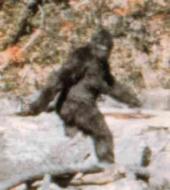
Conversions $100
356 m = __________km

Slide 3
Conversions $100 Answer
356.0 m = 0.356 km

Slide 4
Conversions $200
300 ml = ___________ l

Slide 5
Conversions $200 Answer
300.0 milliliters = 0.300 liters

Slide 6
Conversions $300
0.34 kg = ____________dg

Slide 7
Conversions $300 Answer
0.34 kilograms = 3,400 decigrams

Slide 8
Conversions $400
< , > , or =
34 cm 0.0034 hm

Slide 9
Conversions $400 Answer
34 centimeters = 0.0034 hectometers

Slide 10
Conversions $500
< , > , or =
34,000,000 mm 350 km

Slide 11
Conversions $500 Answer
34,000,000 millimeters < 350 kilometers

Slide 12
Very Variable $100
Describes how the independent variable affects the dependent variable

Slide 13
Very variable $100 Answer
Testable question

Slide 14
Very Variable $200
An if, then because statement that describes an educated guess as to the answer to your testable question

Slide 15
Very Variable $200 Answer
Hypothesis

Slide 16
Very Variable $300
This group does not receive the independent variable and is
often used for data comparison.

Slide 17
Very Variable $300 Answer
Control group

Slide 18
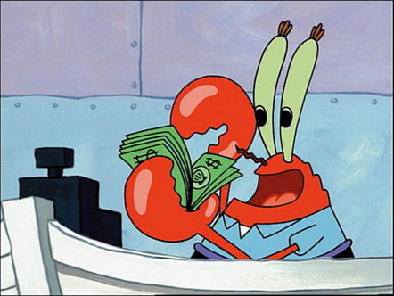
Very Variable $400
Identify the 2 standardizing variables:
Mr. Krabs created a secret ingredient for a breath mint that he thinks will “cure” the bad breath people get from eating krabby patties at the Krusty Krab. He asked
100 customers with a history of bad breath to try his new breath mint
50 customers (Group A) eat a breath mint after they finished eating a krabby patty.
50 customers (Group B) also received a breath mint after they finished the sandwich, however, it was just a regular breath mint and did not have the secret ingredient.
Both groups were told that they were getting the breath mint that would cure their bad breath. Two hours after eating the krabby patties, 30 customers in Group A and 10 customers in Group B reported having better breath than they normally had after eating krabby patties.

Slide 19
Very variable $400 Answer
Krabby patty
2 hour wait time

Slide 20
Very variable $500
Identify what SpongeBob did wrong in this experiment:
SpongeBob loves to garden and wants to grow lots of pink flowers for his pal Sandy. He bought a special Flower Power fertilizer to see if will help plants produce more flowers. He plants two plants of the same size in separate containers with the same amount of potting soil. He places one plant in a sunny window and waters it every day with fertilized water. He places the other plant on a shelf in a closet and waters it with plain water every other day.

Slide 21
Very variable $500 Answer
SpongeBob did not provide both plants with the same amount of water and sunshine. In order to test the fertilizer correctly, both plants should have been placed in the sunny window and watered every day with the same amount of water. The only difference between the two plants should have been the fertilizer - one plant would be watered with the water with fertilizer and the other would be watered with plain
water.

Slide 22
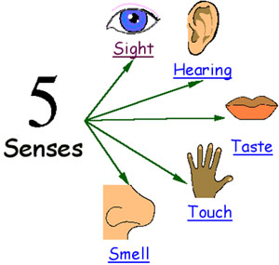
Did You See that? $100
Type of observation that uses the 5 senses

Slide 23
Did You See that? $100 Answer
Qualitative observations/data

Slide 24
Did You See that? $200
Type of observation that consists of measurements, or amounts such as volume, length, acceleration.

Slide 25
Did You See that? $200 Answer
Quantitative observations

Slide 26
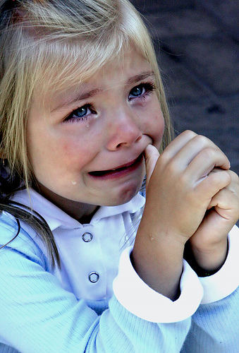
Did You See that? $300
What would an inference be for this observation?
Observation: The little girl is crying at the playground.

Slide 27
Did You See that? $300 Answer
Assorted answers

Slide 28
Did You See that? $400
List 5 quantitative observations about this classroom.

Slide 29
Did You See that? $400 Answer
Assorted answers

Slide 30
Did You See that? $500
Qualitative or quantitative data?
Jenny wanted to see if Miracle Makeup helped her to look like Madonna. She put Miracle Makeup on forty of her friend’s faces and nothing on her own face. Over a week’s time, she recorded whether or not their faces looked like Madonna’s.

Slide 31
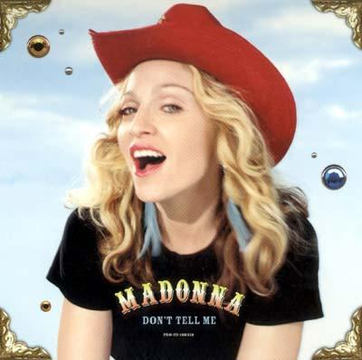
Did You See that? $500 Answer
Qualitative observations/data

Slide 32
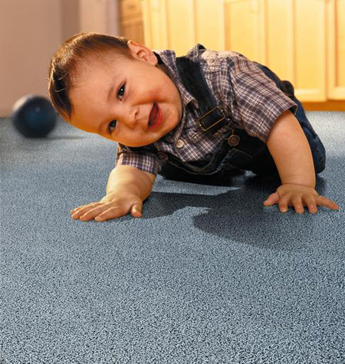
Number Game $100
Which metric unit would we use to measure a length of carpet?

Slide 33
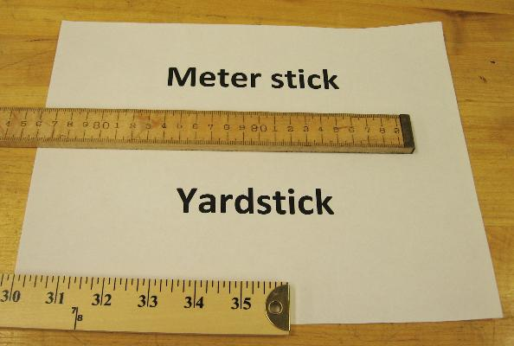
Number game $100 Answer
The meter

Slide 34
number game $200
What property of an object is measured in grams?

Slide 35
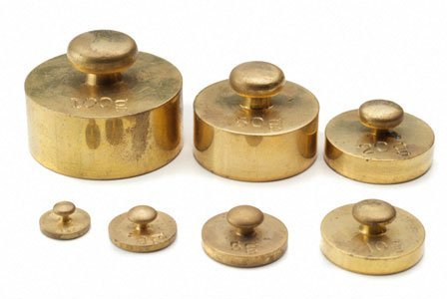
number game $200 Answer
We measure MASS in grams

Slide 36
number game $300
Type of graph used to show the relationship between two variables

Slide 37
number game $300 Answer
Line graph

Slide 38
number game $400
The two options for a data table/graph title are….

Slide 39
number game $400 Answer
testable question for experiment
independent variable vs. dependent variable

Slide 40
number game $500
The x-axis is labeled with the ______ variable and the y-axis is labeled with the _______ variable on a graph.

Slide 41
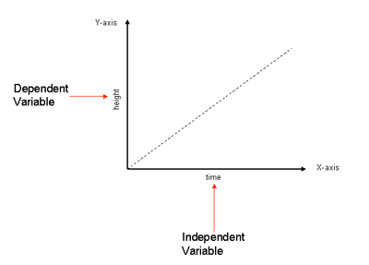
number game $500 Answer
x-axis: independent & units
y-axis: dependent & units

Slide 42
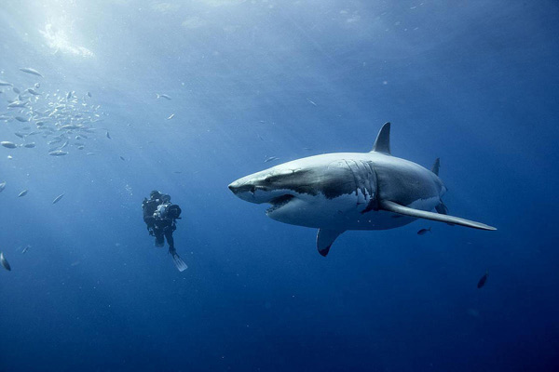
mixed bag $100
Which is the smallest ocean?

Slide 43
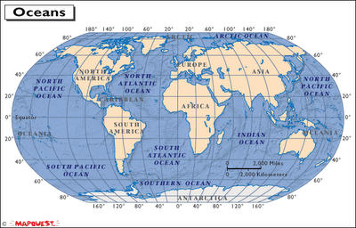
mixed bag $100 Answer
Arctic Ocean
-area of 5.4 million sq miles
-1.5X size of U.S.

Slide 44
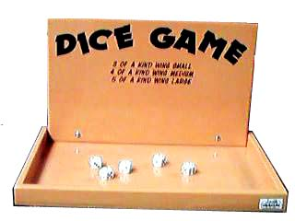
mixed bag $200
What do the opposite sides of a dice add up to?

Slide 45
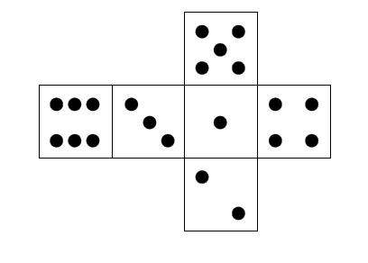
mixed bag $200 Answer
7

Slide 46
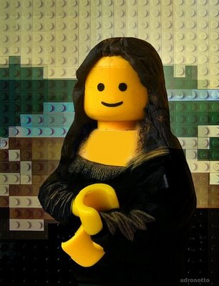
mixed bag $300
Which artist painted the Mona Lisa?

Slide 47
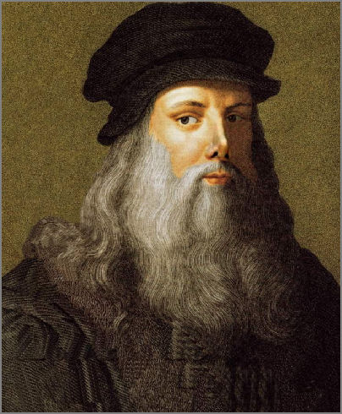
mixed bag $300 Answer
Leonardo
DaVinci

Slide 48
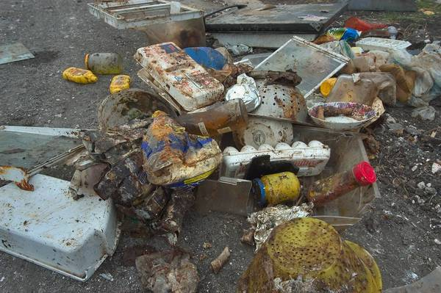
mixed bag $400
What is the only food that doesn’t spoil?

Slide 49
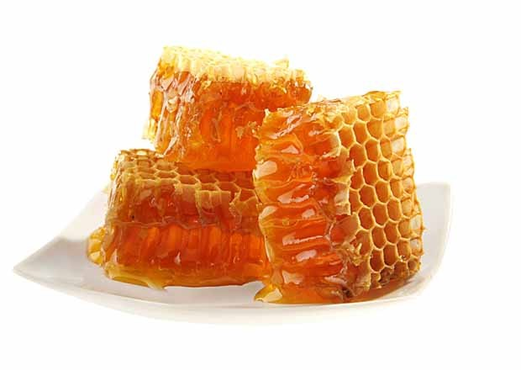
mixed bag $400 Answer
Honey

Slide 50
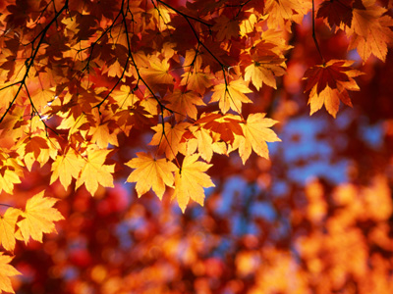
mixed bag $500
Why do the leaves change colors during autumn?

Slide 51
mixed bag $500 Answer
Chlorophyll [green pigment in leaves that help plants make food (photosynthesis)] ‘disappears’ from leaves during autumn because trees live off stored food from the summer during the winter. When the chlorophyll ‘disappears’ other pigments in the leaves [yellow, orange, red] are able to shine through!

Slide 52
Final Jeopardy
List the 7 steps of the scientific method

Slide 53
Final Jeopardy Answer
Question
Purpose
Introduction [Research]
Hypothesis
Materials/Experimental Procedure
Data Analysis
Conclusion/Results

